Slide 1
Advisory Report 4
Shrey Agrawal Jiayi Chen
David Dai Hong Doan
May 2, 2023

Slide 2

Agenda
Business Understanding Revisit
Goals Statements & Our Work
Reflections
Moving Forward

Slide 3
Business Understanding Revisit
“Build A Better Grinnell” is a community-based initiative aimed at improving the quality of life in Grinnell, Iowa.
The goal is gather data from the focus population (Grinnell residents), collect innovation from the base and have a shared understanding of strengths, visions, and priorities.

Slide 4
Goals Statements - What to Expect
Sentiment Deep Dive
Goal 1: Keywords for Positives and Negatives of a neutral question
Sentiment Analysis SQUARED
Goal 2: People who always responded positively / negatively
Goal 3: The results of sentiment analysis on one question stacked on another. e.g. People who responded positively for question 1 who then responded negatively for question 3.
Clustering SQUARED
Goal 4: Analyzing clusters
e.g. People Like XXX say Grinnell lacks XXX

Slide 5
Goal #1
Keywords for Positives and Negatives
Find Questions with Even Positives and Negatives
Looking into keywords for the Positives and Negatives

Slide 6
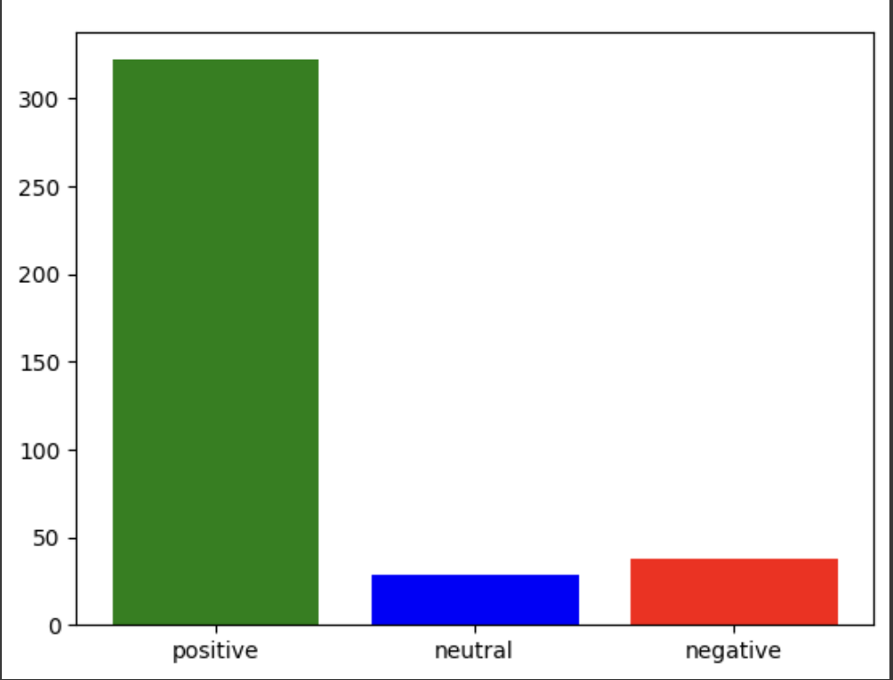
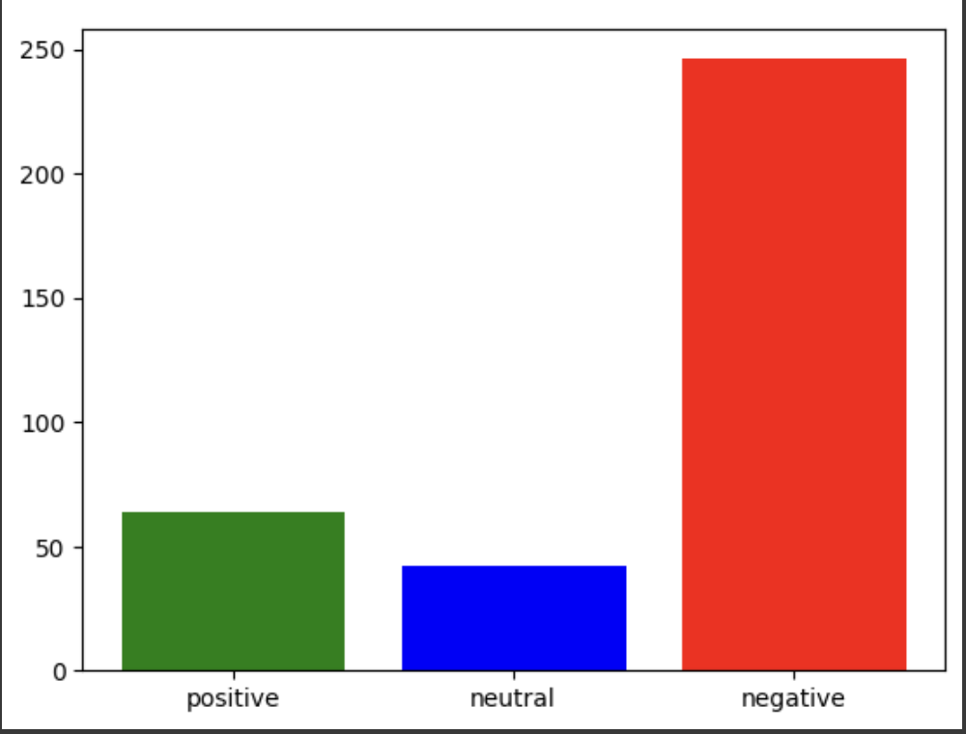
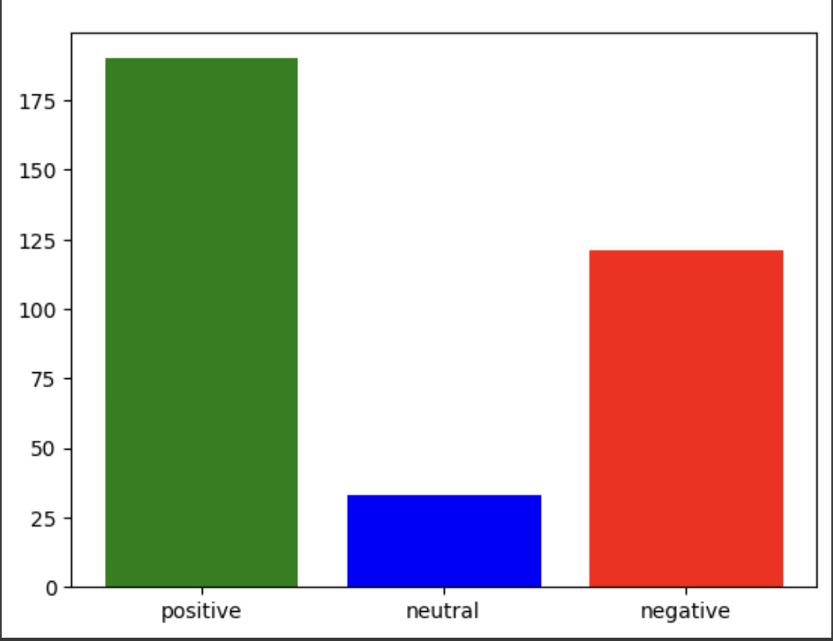
Question 4: Do you think Grinnell has a set of core values? (e.g. what is important, what we believe, principles guiding our behavior) What do you think they are?
Question 1: What are things that make you glad to live in Grinnell?
Question 7: Have there been things that have made you consider leaving Grinnell? What were they?

Slide 7
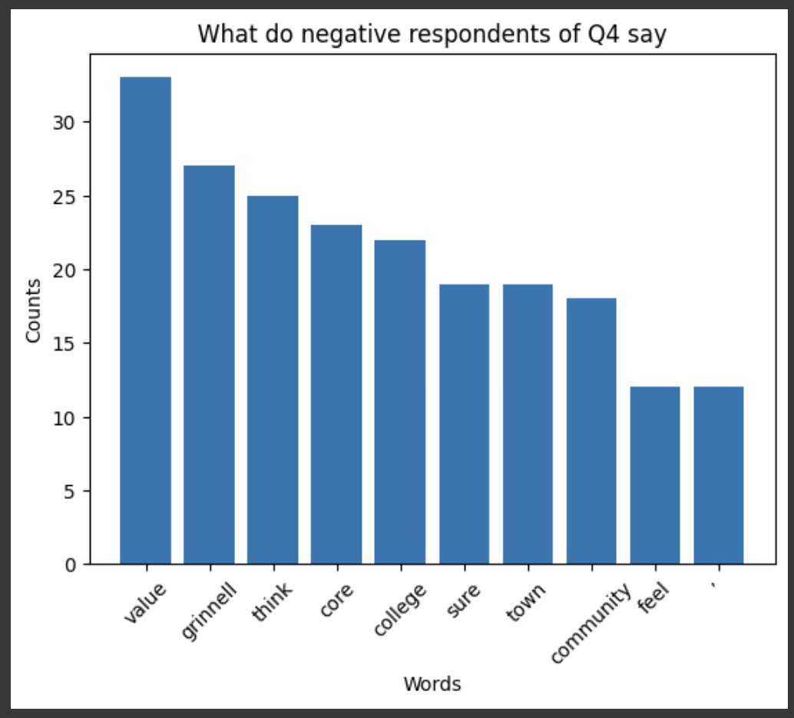
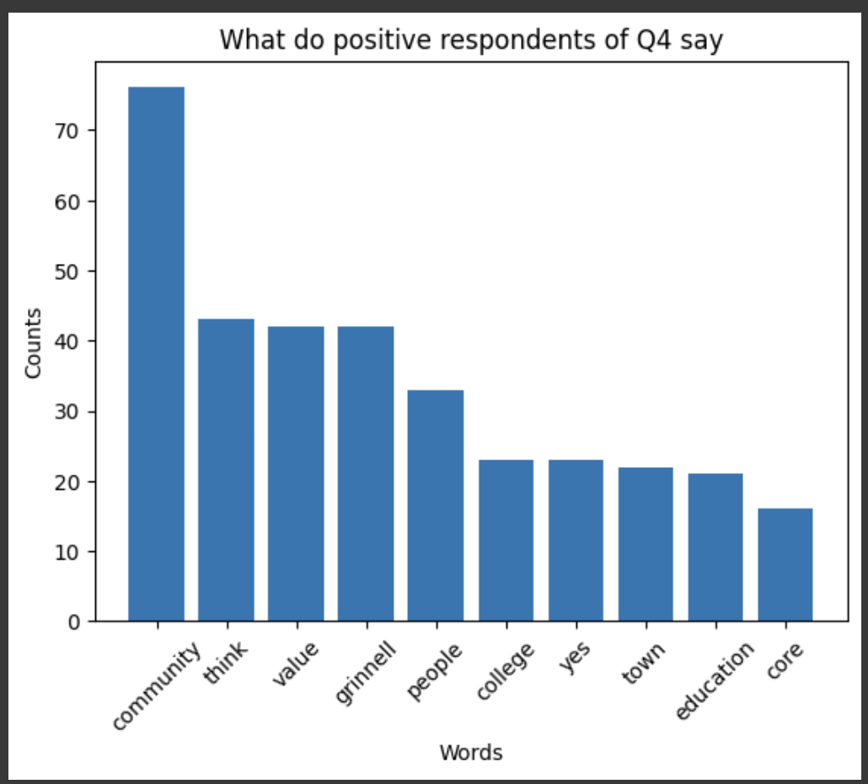
Question 4: Do you think Grinnell has a set of core values? (e.g. what is important, what we believe, principles guiding our behavior) What do you think they are?

Slide 8
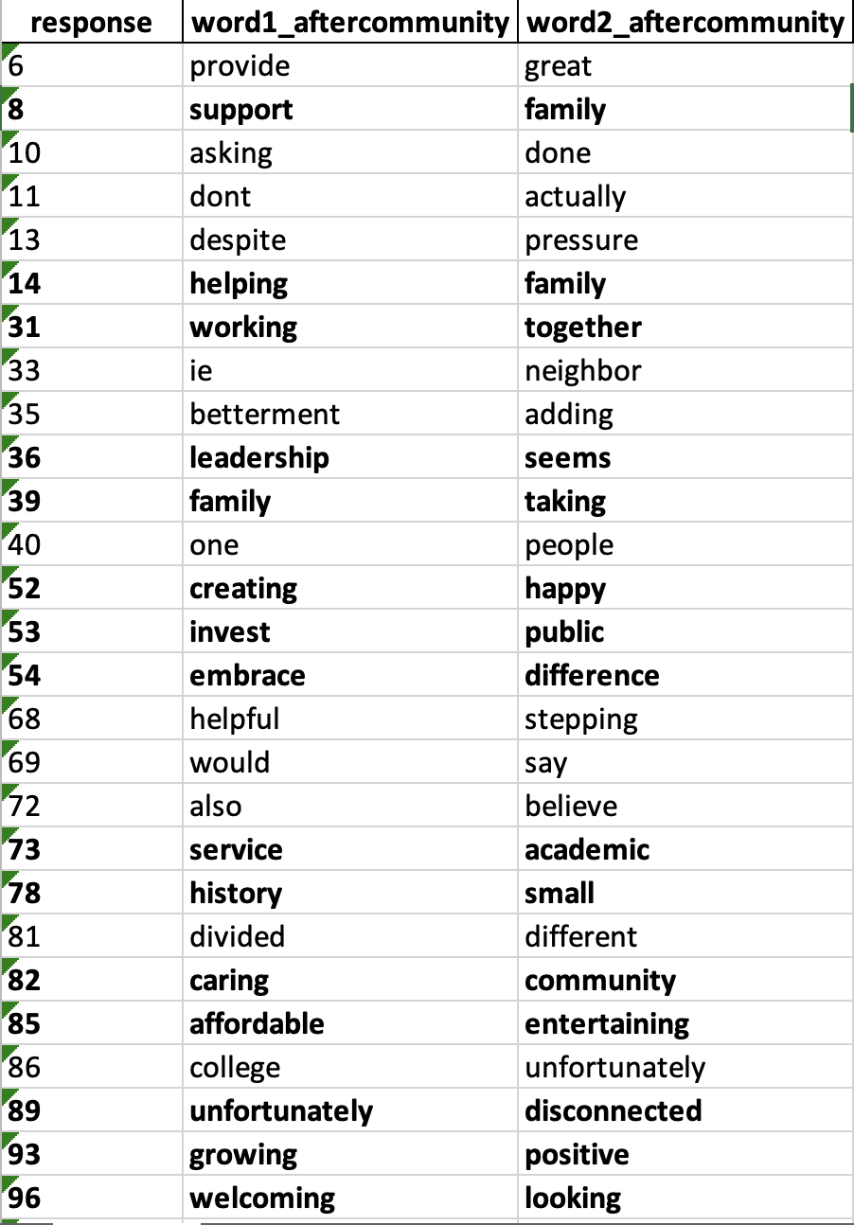
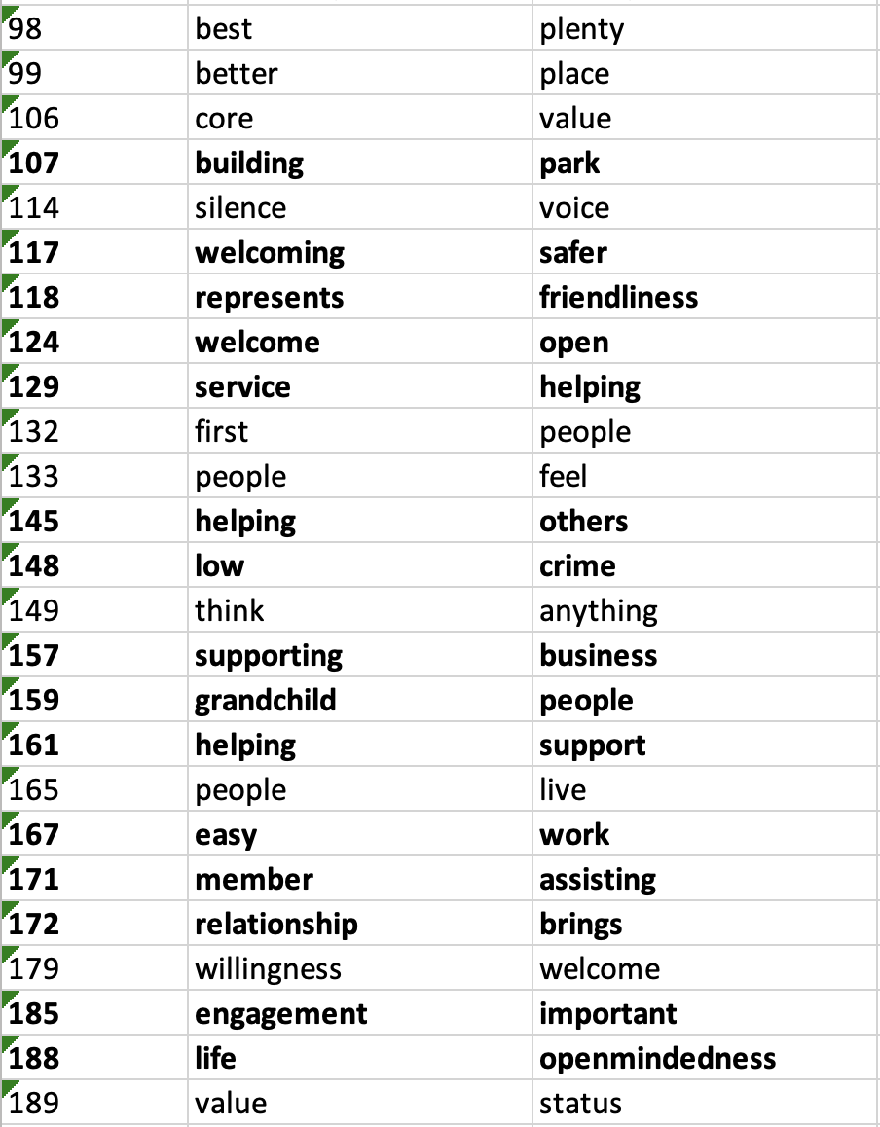
Question 4: Do you think Grinnell has a set of core values? (e.g. what is important, what we believe, principles guiding our behavior) What do you think they are?
POSITIVE

Slide 9
Goal #2.1
Sentiment Pattern - Always
People who always responded positively / negatively
Since there’s no respondent who ALWAYS answered positively or negatively,
We counted NEVER positives and NEVER negatives.

Slide 10
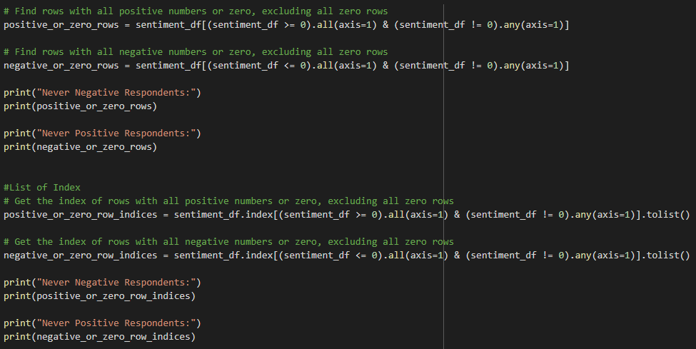
Tech Bubble for Goal #2.1: Sentiment Pattern

Slide 11
Goal #2.1. Results
Never Negative Respondents:
[3, 6, 13, 23, 46, 72, 88, 99, 108, 111, 148, 188, 191, 232, 297, 306, 357, 367, 375, 376, 377, 385, 386, 398, 400, 434, 460, 461, 462, 463, 464, 465, 466, 467, 468, 469, 470, 471, 472, 473, 474, 475, 476, 477, 478, 479, 480, 481, 482, 483, 484, 485, 486, 487, 488, 489, 490, 491, 492, 493, 494, 495, 496, 497, 498, 499, 500, 501, 502, 503, 504, 505, 506, 507, 508, 509, 510, 511, 512, 513, 514, 515, 516, 517, 518, 519, 520, 521, 522, 523, 524, 525, 526, 527, 528, 529, 530, 531, 532, 533, 534, 535, 536, 537, 538, 539, 540, 541, 542, 543, 544, 545, 546, 547, 548, 549, 550, 551, 552, 553, 554, 555, 556, 557]
Never Positive Respondents:
[207, 401, 403, 406, 408, 410, 412, 413, 414, 415, 417] → A lot N/A response & only answer Neutrally or negatively

Slide 12
Supervised Analysis for respondents never negative
People with family, often go to church who likes value people’s connection, safe, quiet neighborhoods, enjoy activities.
They also frustrated about the current condition of Grinnell. They think Grinnell should housing, include more entertainment, especially restaurants and retailers.

Slide 13
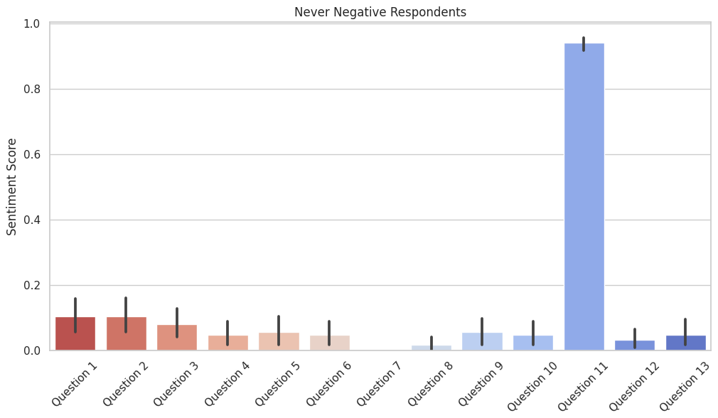
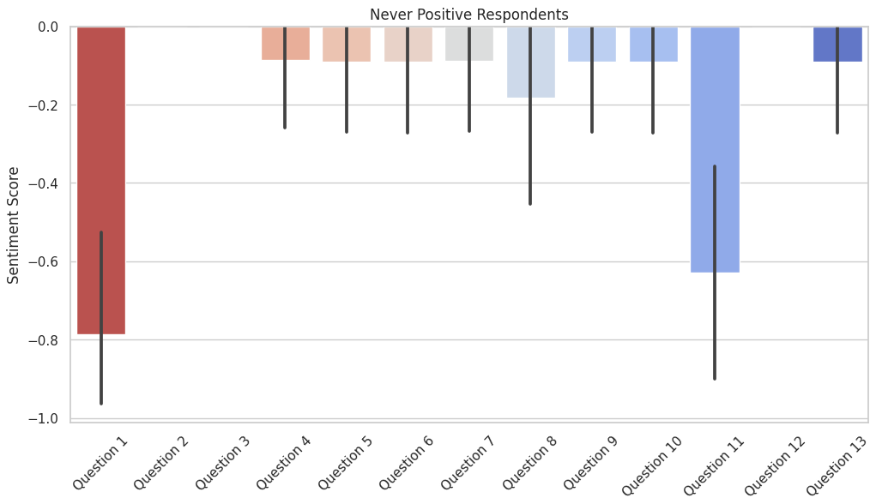
Goal #2.1 Visualization
Q11: If you do not currently live here, what changes in the community would make you more likely to move to Grinnell?
Q1: What are things that make you glad to live in Grinnell?

Slide 14
Goal #2.2
Sentiment Pattern - Average
Average Sentiment
Calculating sentiment for each respondent for each question
Averaging the Sentiment Score of Each Respondent

Slide 15
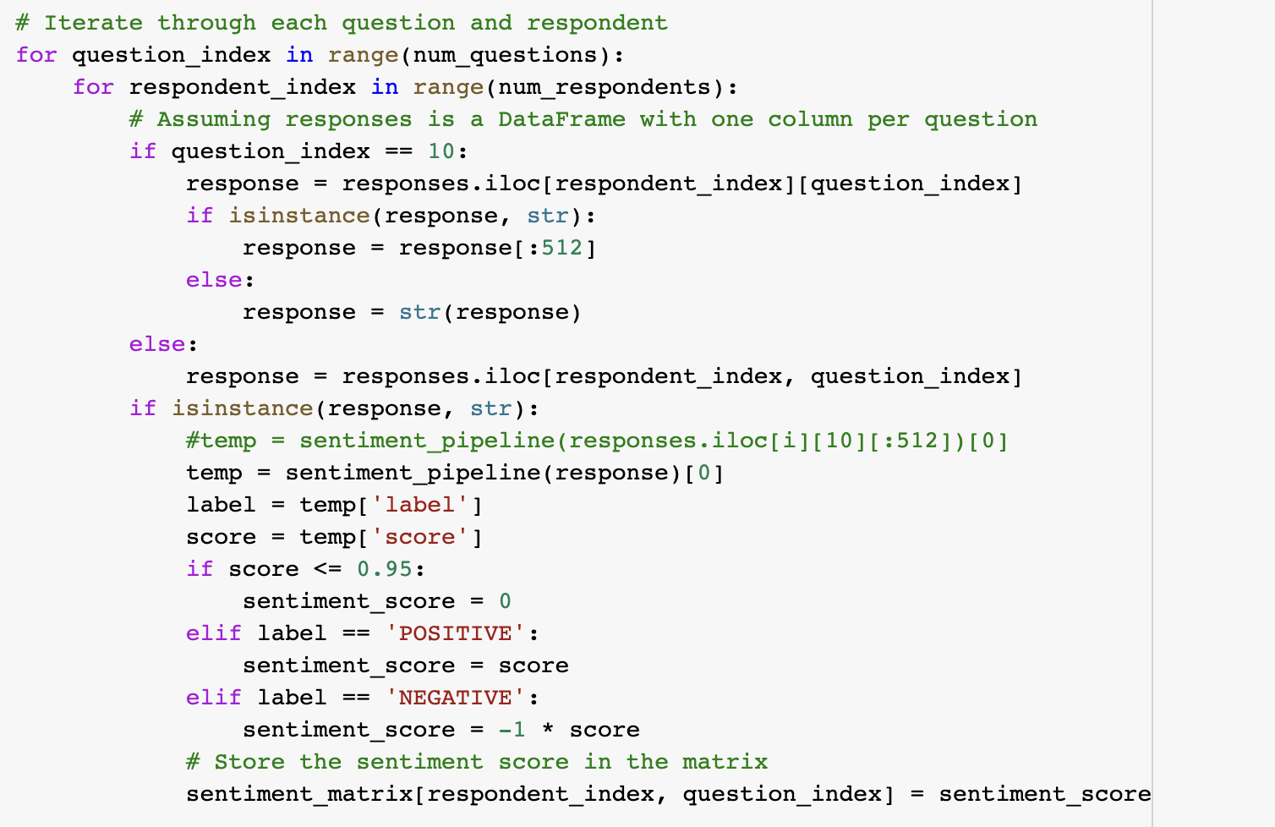
Tech Bubble for Goal #2.1 Sentiment Per Question Per Response

Slide 16
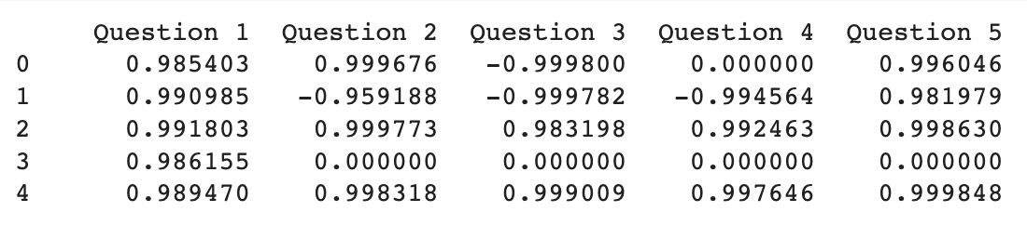

Slide 17
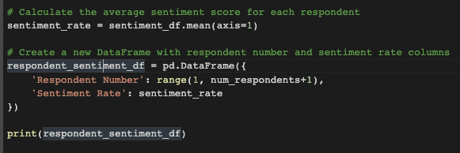
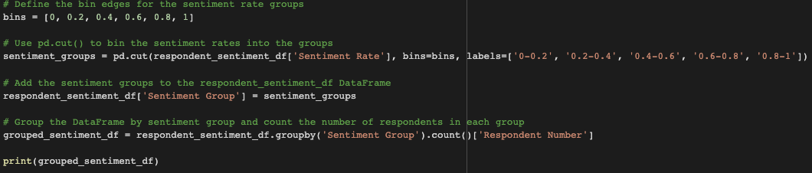
Tech Bubble for Goal #2.2 Average Sentiment

Slide 18
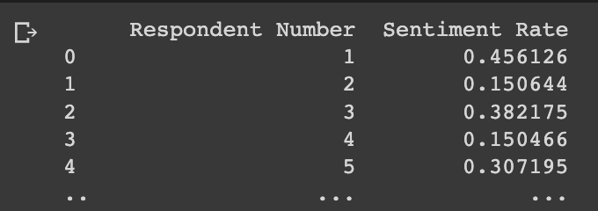
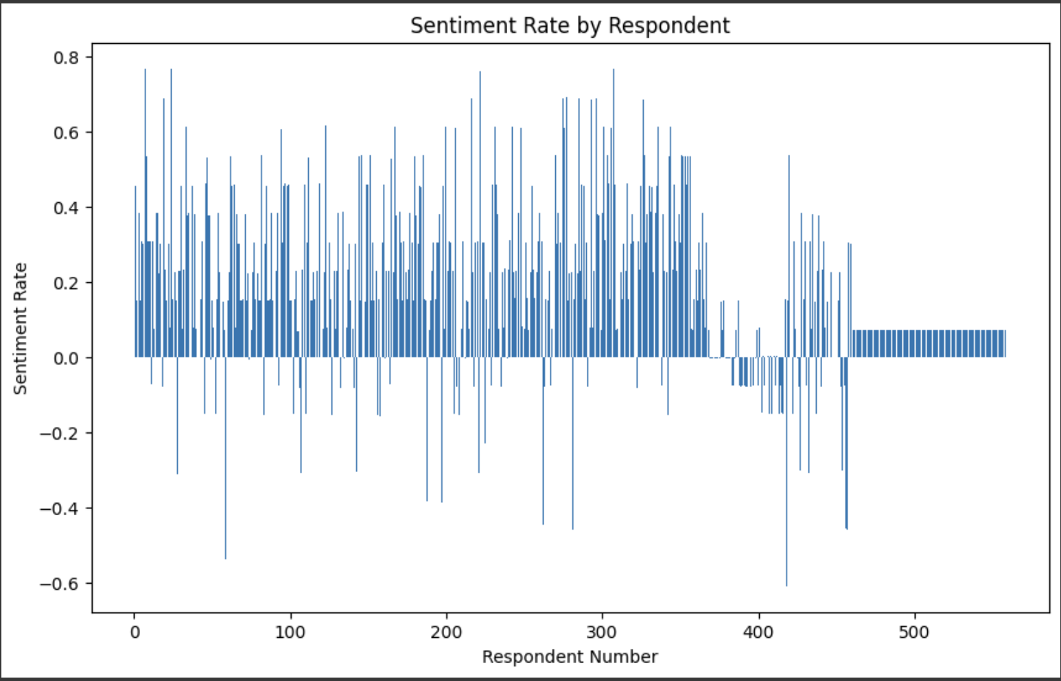
Goal #2.2 Average Sentiment Visualization
Notes:
Sentiment rate for each respondents → generally Neutral

Slide 19
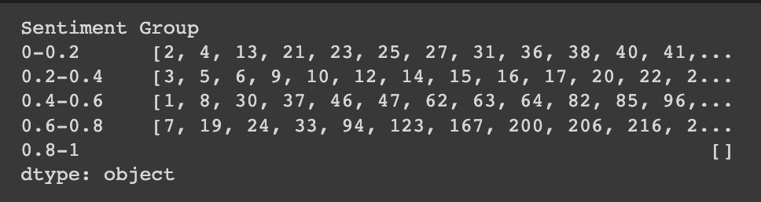
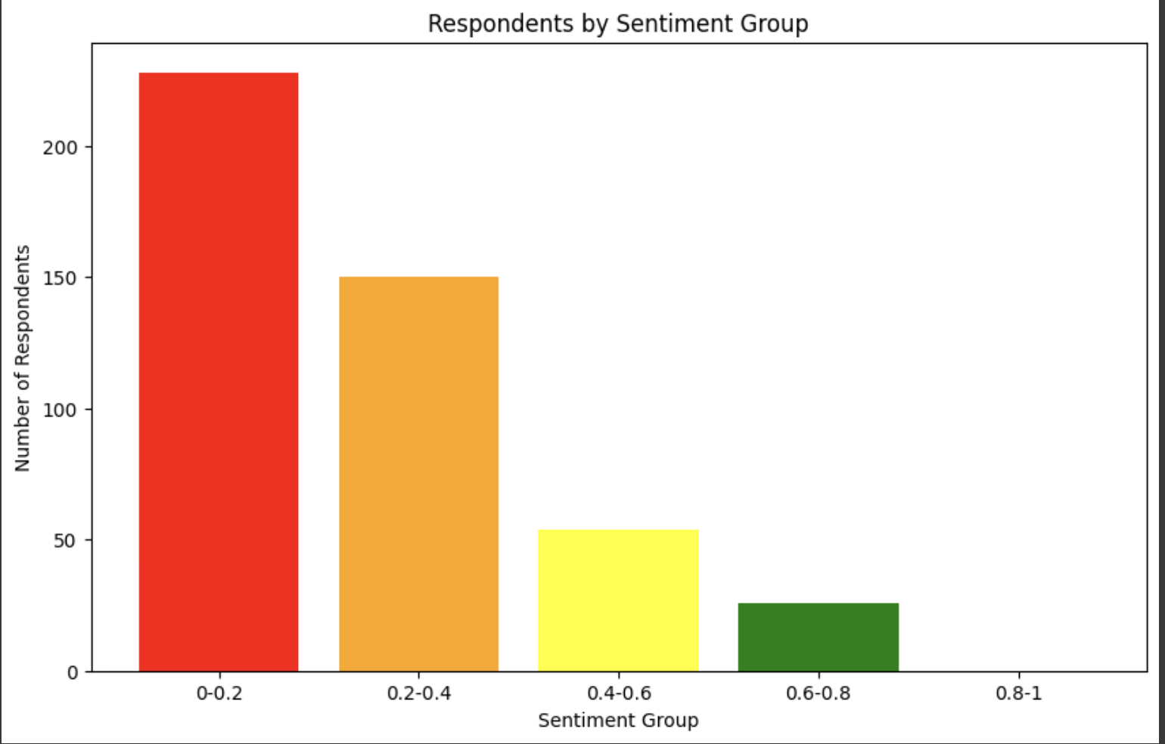
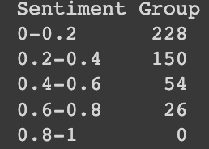
Goal #2.2. Results - Average Sentiment
Notes:
26 ppl over 60% positive ---> what group number shows

Slide 20
Goal #3
Stacking Sentiment Analysis
Stacking Frequency Table
The results of sentiment analysis on one question stacked on another.
e.g. People who responded positively for question 1 who then responded negatively for question 3.

Slide 21
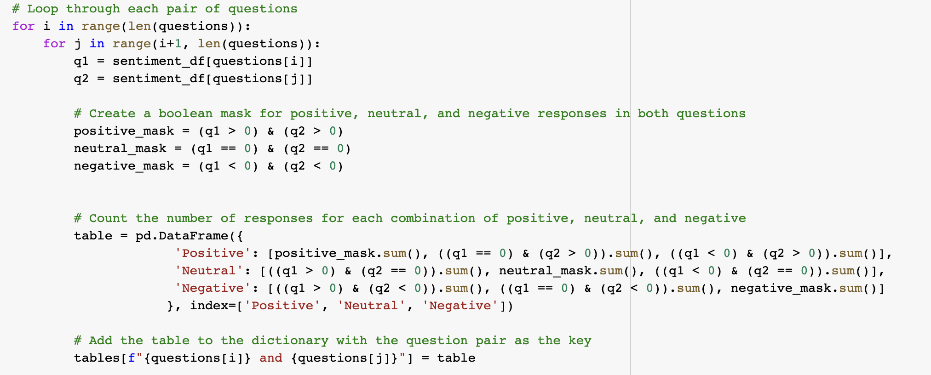
Tech Bubble for Goal #3: Stacking Sentiment Analysis

Slide 22
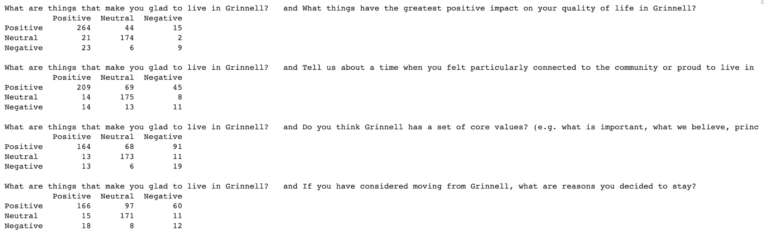
Goal #3. Results

Slide 23
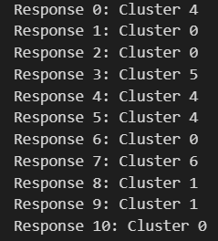
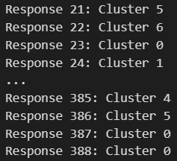
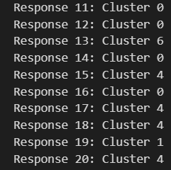
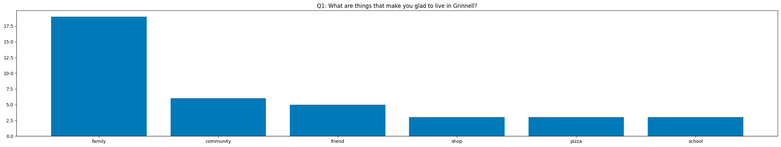
Goal #4
Analyzing k-means Clusters
Review: K-means clustering is a method of vector quantization that aims to partition n observations into k clusters in which each observation belongs to the cluster with the nearest mean
Previous progress:
Category: family

Slide 24
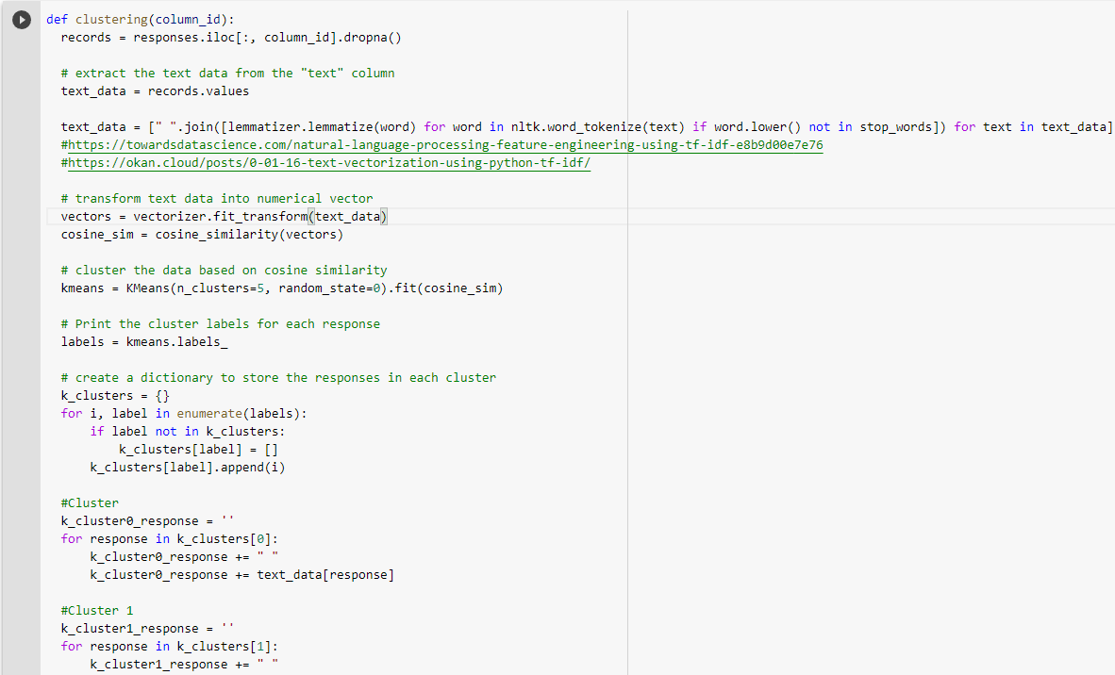
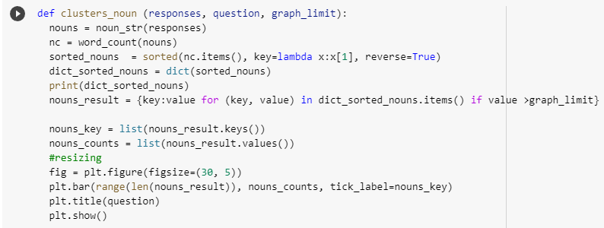
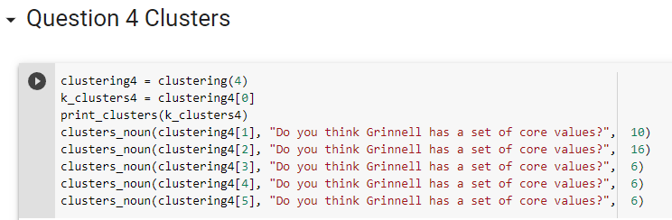
Technical improvement: Making functions using existing scripts

Slide 25
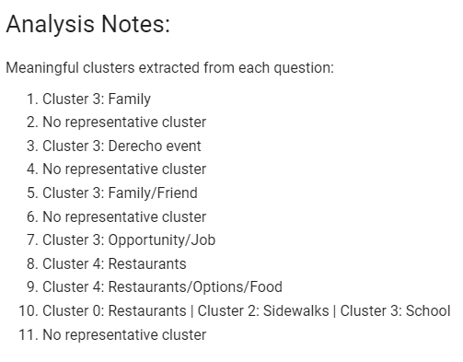
Deliverable 1:

Slide 26
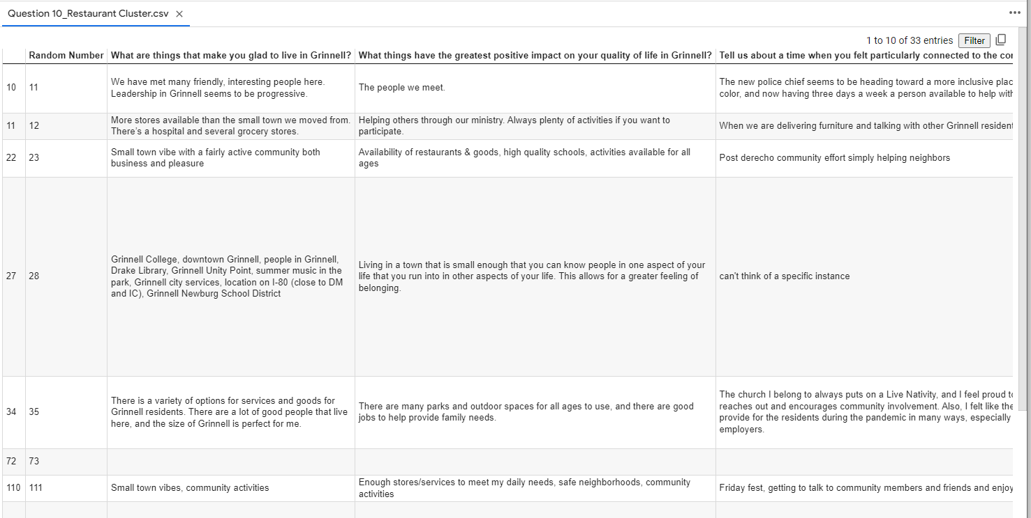
Deliverable 2: Exporting spreadsheet for meaningful clusters

Slide 27
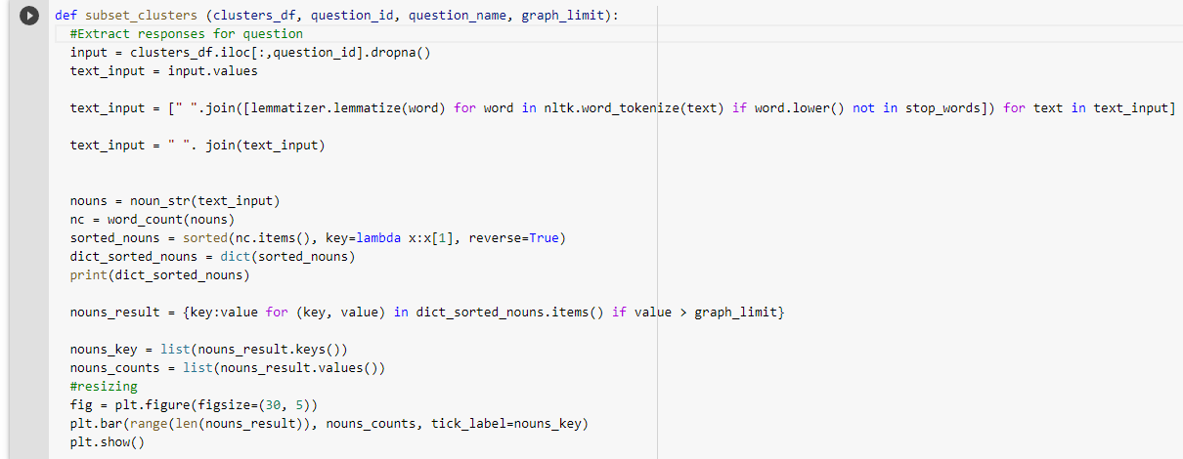
Deliverable 3: People Like XXX say Grinnell lacks XXX

Slide 28
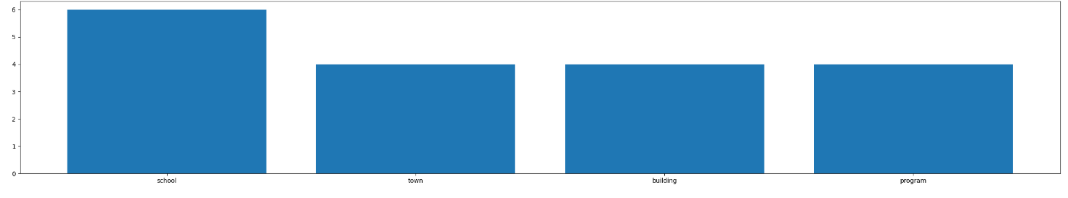
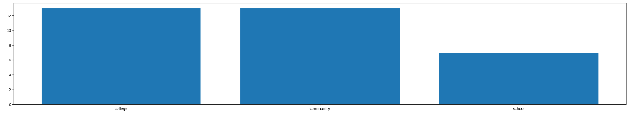
People who mentioned “family/friends” as what made them glad to live in Grinnell
frequently also mentioned “school” as what they want to see if fund is unlimited
People who mentioned “restaurants” as changes they want to make if fund is unlimited
frequently also mentioned “college./school” as what made them frustrated

Slide 29
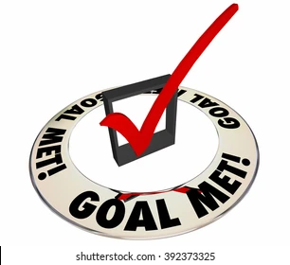
Reflections
Sentiment Deep Dive
Keywords for Positives and Negatives
Sentiment Pattern
People who always responded positively / negatively
Average sentiment for each respondent
Stacking Sentiment
e.g. People who responded positively for question 1 who then responded negatively for question 3.
K-mean Clustering Analysis
Technical improvement and 3 deliverables available

Slide 30

Moving Forward
Further explore the matrix between two questions
Focusing on neutral responses & responses
Stacked sentiment matrices: Further analysis, including looking at people who responded negatively to one question responding positive to other questions
Screen out certain responses for a given question
Tailoring project to client’s need
Wrapping up final deliverable
Make the data analysis as replicable for future surveys/responses

